Slide 1
Summary of findings on Airbnb
Zhongyi “Lucy” Li

Slide 2
Targets
Estimate mean and variance of airbnb prices in New York, San Francisco and Los Angeles
Evaluate factors that influence the prices

Slide 3
Price-influencing factors to be considered
Neighborhoods (Brooklyn, Queens…)
Restrictions: instant_bookable, cancellation_policy, min_nights, require_guest_profile_picture, security_deposit_native
Facility: bathrooms, bedrooms, beds, property_type (house, apartment…), room_type_category (entire_home, private_room), amenities (TV, Internet…)
Descriptions: picture_count, reviews_count, star_rating, review_rating_valuem
Host parameters: identity_verified, is_superhost

Slide 4
Data extraction
IDs of posts are extracted from the urls using import.io.
The detailed information is extracted by IDs as reference using API.

Slide 5
Data cleaning
”shared_room” posts are deleted.
Only “real_bed” posts are kept.
Cleaning fee is considered part of the price.
47 indicator variables are created for the amenities
The following variables are considered numeric variables: price, bedrooms, bathrooms, beds, min_nights, person_capacity, picture_count, length_amenities_ids, cleaning_fee_native, security_deposit_native, review_rating_value, reviews_count, star_rating

Slide 6
Model selection
Data is split into 2/3 training set and 1/3 test set.
Models: Random forest Boosting LASSO Ridge regression Neural networks

Slide 7
Findings

Slide 8
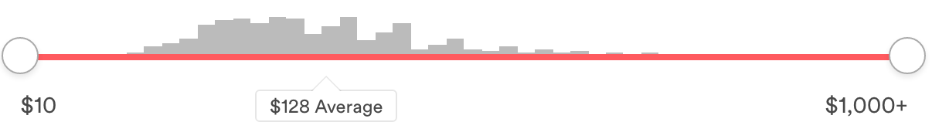
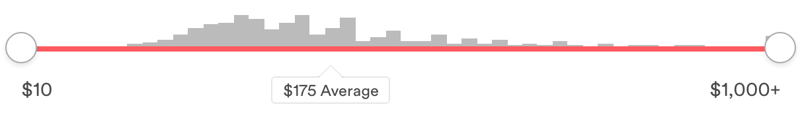
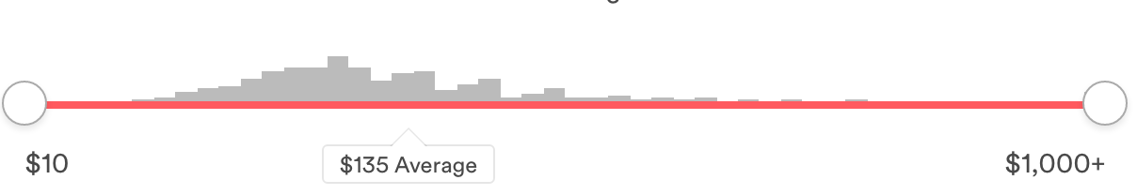
Average and standard deviation of the price
NY
 | Average | Standard deviation
NY | 123.9 | 79.3
SF | 156.4 | 70.4
LA | 109.9 | 83.1
SF
LA

Slide 9
Shared factor affecting price: neighborhoods
NY

Slide 10
Shared factor affecting price: neighborhoods
SF

Slide 11
Shared factor affecting price: neighborhoods
LA

Slide 12
Unique factors affecting price
NY Amenities: suitable for events, washer, wheelchair, pool
LA Amenities: TV, gym

